Slide 1

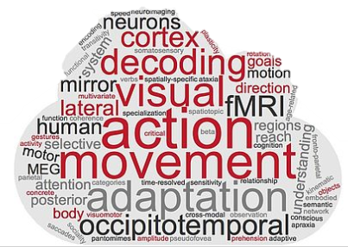
ROI-based RSA
Day 2
Tonghe & Zuza

Slide 2
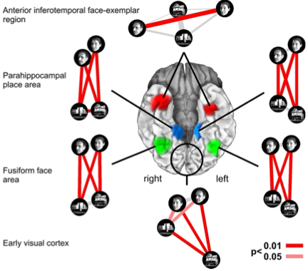
Characterizing brain regions by representational similarity structure
Kriegeskorte et al., 2008

Slide 3
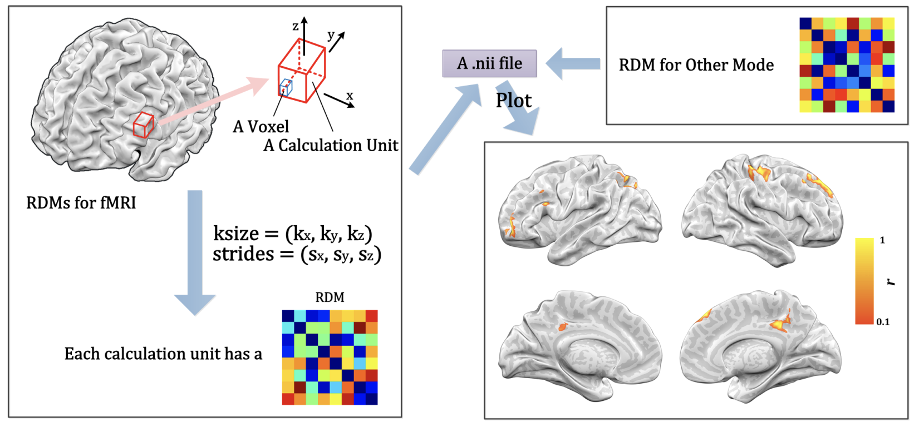
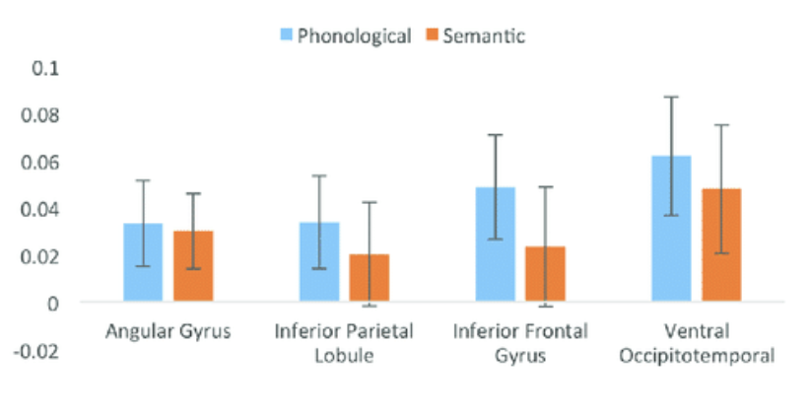
ROI-based RSA – step by step
Lu & Ku, 2020
Fisher-Baum, et al., 2018

Slide 4
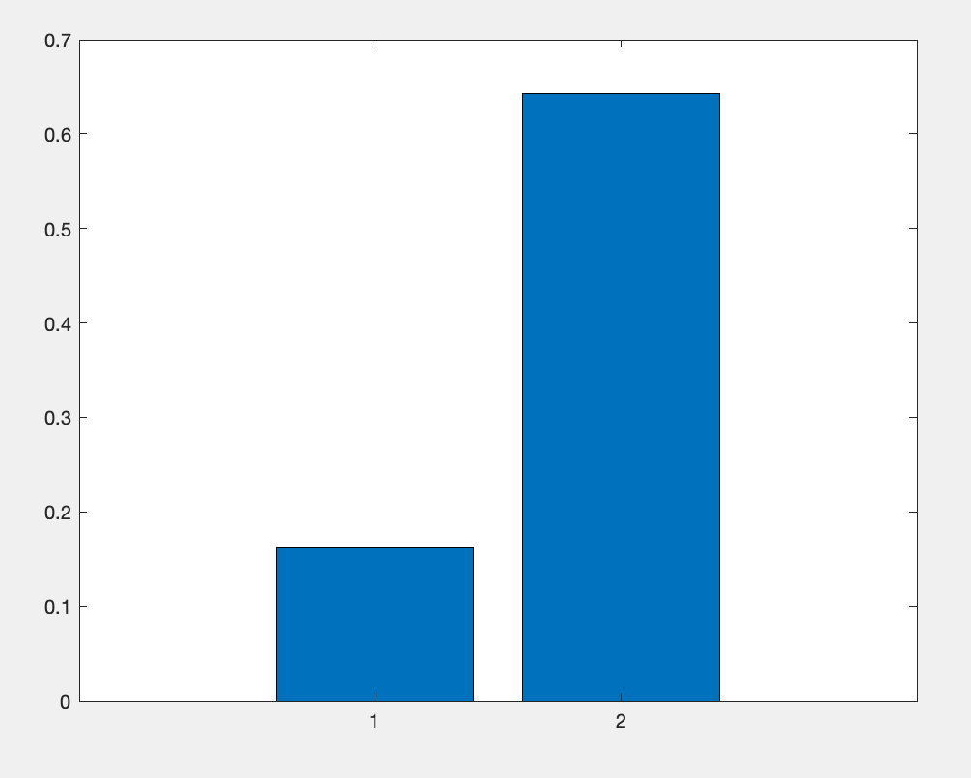
Exercise
Load your own behavioral matrix and save the file as my_rMat.mat (my_rMat.mat).
Get correlation values, mean across the participants
Plos it
Compare different correlation metrics and plot them
Pearson
Spearman
Kendal

Slide 5
RSA: ROI-based statistics

Slide 6
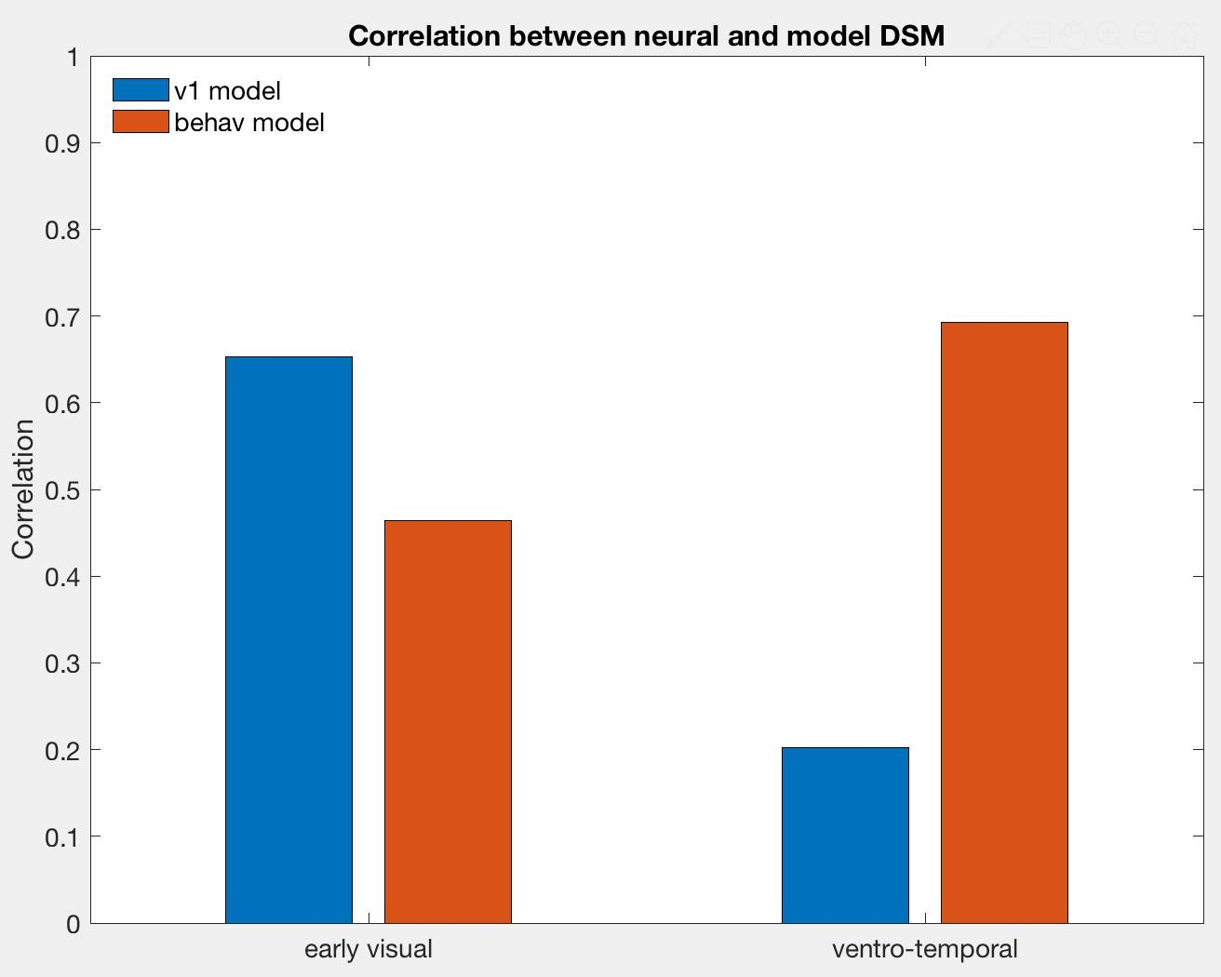
Statistics with matlab
8 subjects
results against with 0
between ROIs
between models
2 ROIs X 2 models
anova by spss or R or matlab

Slide 7
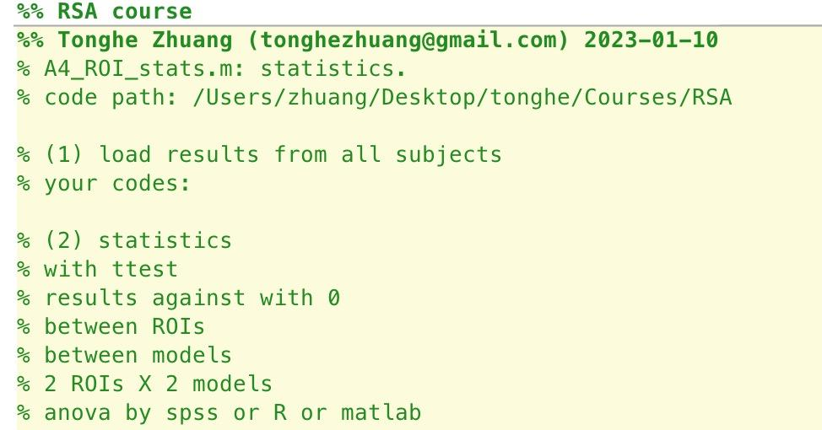

Slide 8
